Slide 1
CPBP 8306: Statistics & visualization day 2
Stevenson Science & Engineering Library
Joshua Borycz

Slide 2
Tidy models

Slide 3
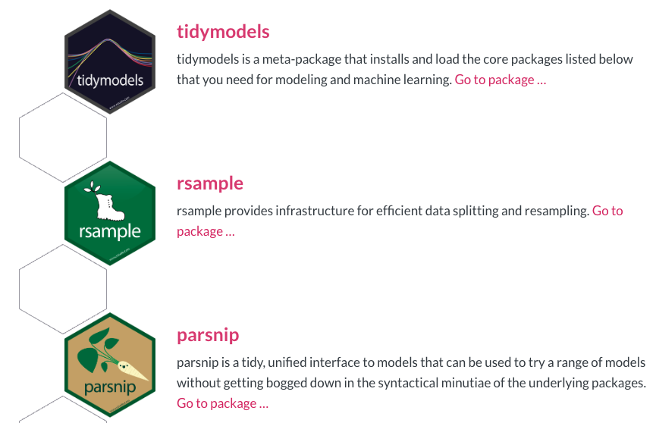
Tidy models: Packages
Notes:
Note: We have only restructured the data and removed non data content (e.g., title and descriptions)
The data still contains the same number of cells, but now facilitates machine analysis
Good practice to only include data in your data file and all other contextual information should be addressed in other locations (e.g., ReadMe, data dictionary)

Slide 4
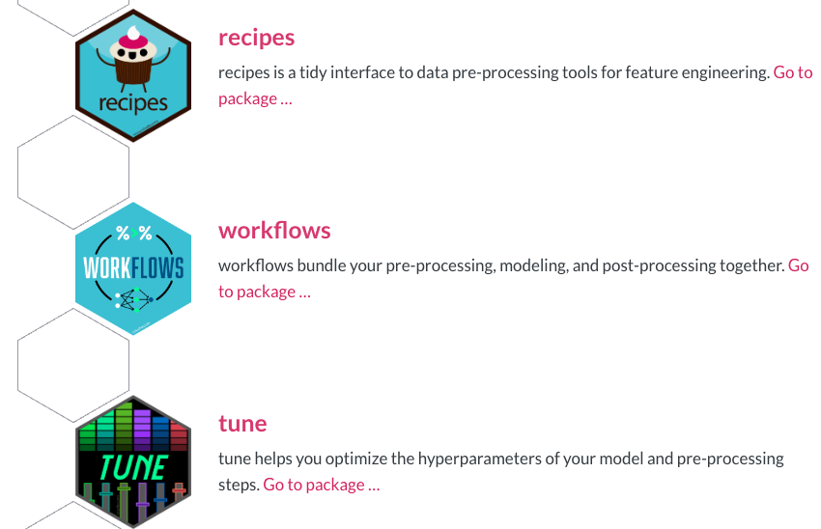
Tidy models: Packages
Notes:
Note: We have only restructured the data and removed non data content (e.g., title and descriptions)
The data still contains the same number of cells, but now facilitates machine analysis
Good practice to only include data in your data file and all other contextual information should be addressed in other locations (e.g., ReadMe, data dictionary)

Slide 5
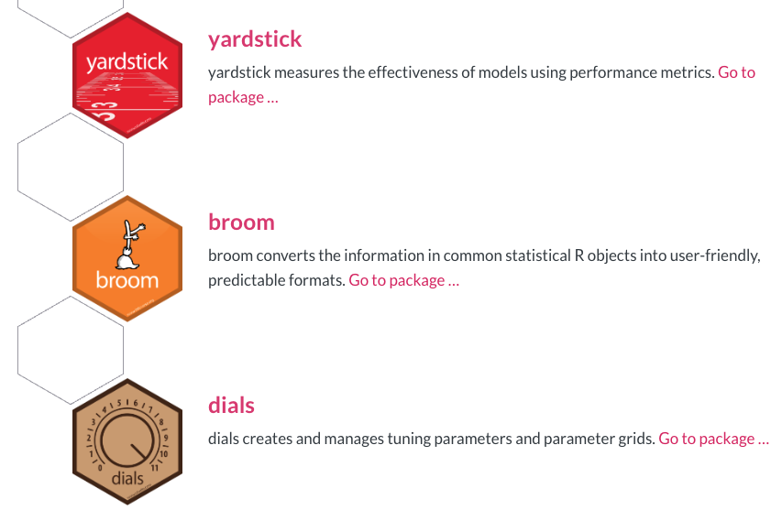
Tidy models: Packages
Notes:
Note: We have only restructured the data and removed non data content (e.g., title and descriptions)
The data still contains the same number of cells, but now facilitates machine analysis
Good practice to only include data in your data file and all other contextual information should be addressed in other locations (e.g., ReadMe, data dictionary)

Slide 6
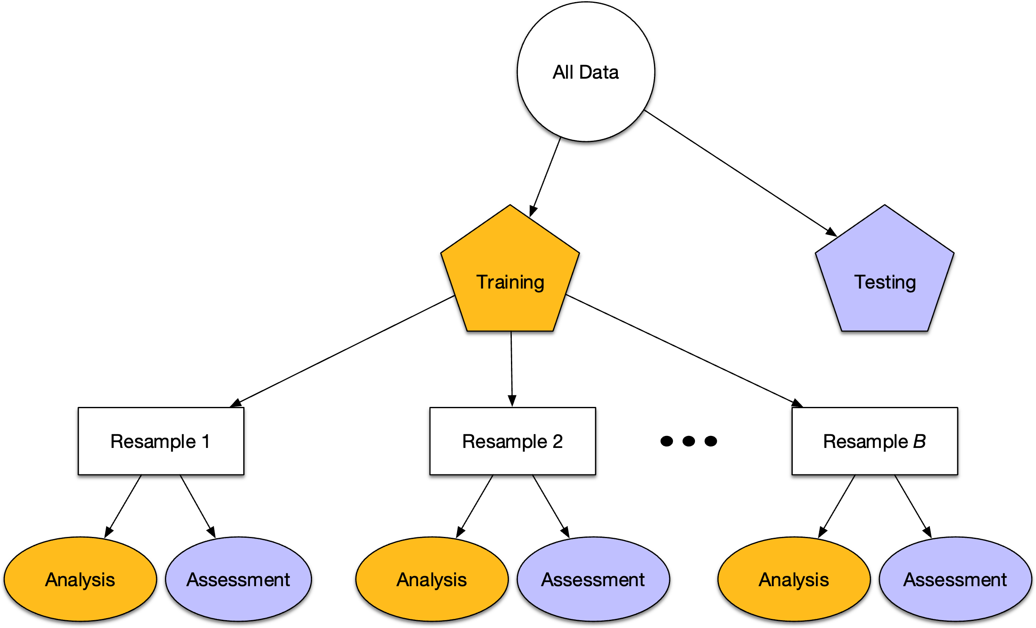
Tidy models: Steps
Data Splitting: Splitting the dataset into training and testing sets using initial_split()
Model Definition: Defining the model to be used, such as linear regression, decision tree, random forest, etc., using functions like linear_reg(), decision_tree(), rand_forest()
Model Tuning: Tuning the model hyperparameters using tune_grid() and cross-validation
Model Fitting: Fitting the final model to the training data using fit()
Model Evaluation: Evaluating the model's performance on the test data using metrics like RMSE and R-squared
Notes:
Note: We have only restructured the data and removed non data content (e.g., title and descriptions)
The data still contains the same number of cells, but now facilitates machine analysis
Good practice to only include data in your data file and all other contextual information should be addressed in other locations (e.g., ReadMe, data dictionary)

Slide 7
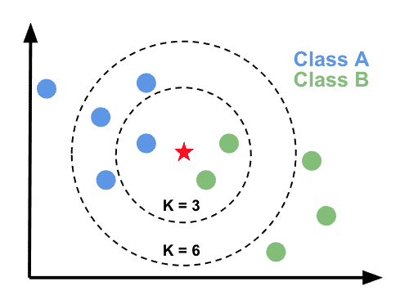
Tidy models: Methods
Linear Regression (linear_reg()): Model the relationship between a dependent variable and one or more independent variables. It aims to find the best-fitting linear equation to describe the relationship between the variables.
Logistic Regression (logistic_reg()): Used for binary classification problems. It models the probability of a binary outcome (e.g., yes/no, true/false) as a function of one or more predictor variables.
Decision Trees (decision_tree()): Supervised learning algorithm that can be used for both classification and regression tasks. They recursively partition the input space based on feature values to make predictions.
Random Forests (rand_forest()): Ensemble learning method that combines multiple decision trees to improve the overall predictive performance and reduce the risk of overfitting.
Boosted Trees (boost_tree()): Ensemble learning method that combines multiple weak decision trees into a strong predictive model. The trees are trained sequentially, with each new tree focusing on the mistakes made by the previous ones.
Notes:
Note: We have only restructured the data and removed non data content (e.g., title and descriptions)
The data still contains the same number of cells, but now facilitates machine analysis
Good practice to only include data in your data file and all other contextual information should be addressed in other locations (e.g., ReadMe, data dictionary)

Slide 8
Tidy models: Methods
Support Vector Machines (svm_rbf(), svm_linear()): Supervised learning algorithm used for both classification and regression tasks. They aim to find the optimal hyperplane that separates different classes or models the relationship between variables.
K-Nearest Neighbors (nearest_neighbor()): Non-parametric algorithm used for both classification and regression tasks. It makes predictions based on the similarity of the input data to the training samples.
Neural Networks (mlp()): Machine learning model inspired by the structure and function of the human brain. They are capable of learning complex non-linear relationships in the data.
Naive Bayes (naive_bayes()): Probabilistic classifier based on Bayes' theorem. It assumes that the features in the data are independent, which allows for efficient model training and prediction.
Notes:
Note: We have only restructured the data and removed non data content (e.g., title and descriptions)
The data still contains the same number of cells, but now facilitates machine analysis
Good practice to only include data in your data file and all other contextual information should be addressed in other locations (e.g., ReadMe, data dictionary)

Slide 9
Methods used today

Slide 10
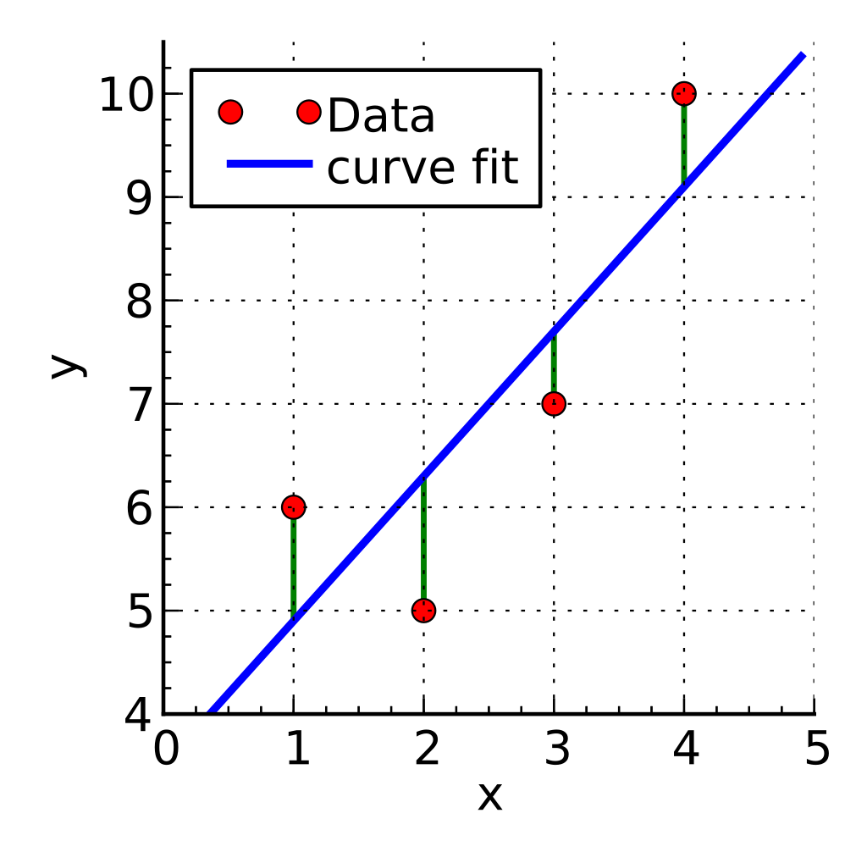
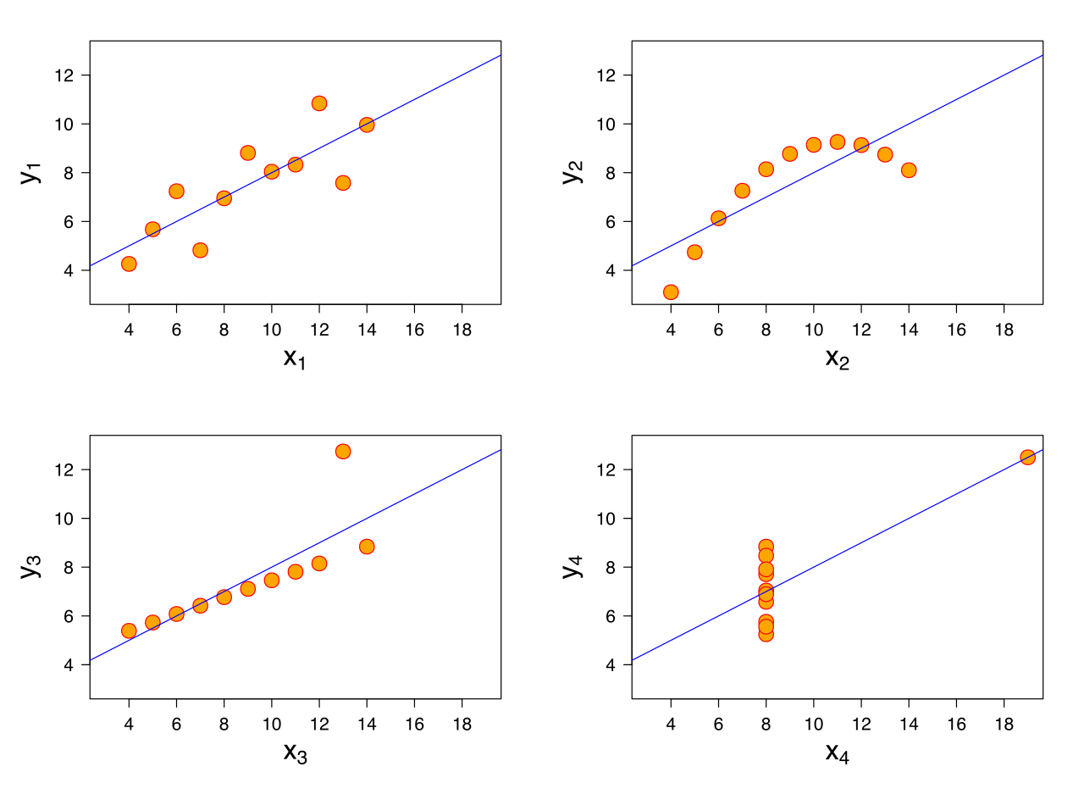
Linear regression
Linear Regression (linear_reg()): Supervised, parametric model the relationship between a dependent variable and one or more independent variables. It aims to find the best-fitting linear equation to describe the relationship between the variables.
Supervised: Algorithm is provided with a set of input features and their associated target outputs, and the goal is to learn a function that can accurately map the inputs to the outputs.
Parametric: Model makes assumption that data relationship is linear.
Regression: Variables are continuous.
Anscombe’s quarter
Notes:
Note: We have only restructured the data and removed non data content (e.g., title and descriptions)
The data still contains the same number of cells, but now facilitates machine analysis
Good practice to only include data in your data file and all other contextual information should be addressed in other locations (e.g., ReadMe, data dictionary)

Slide 11
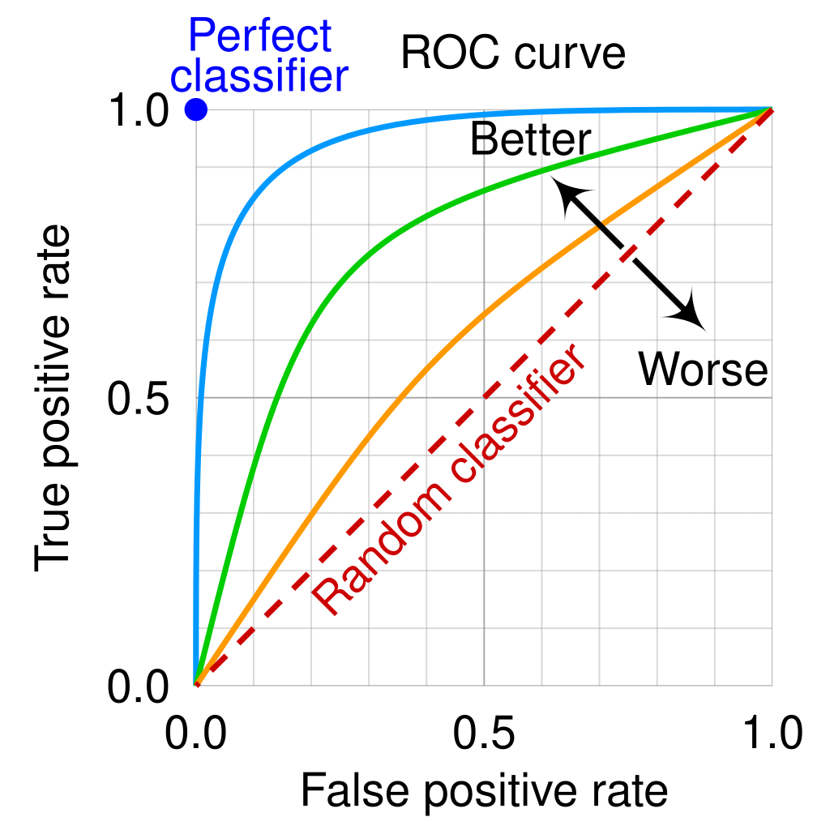
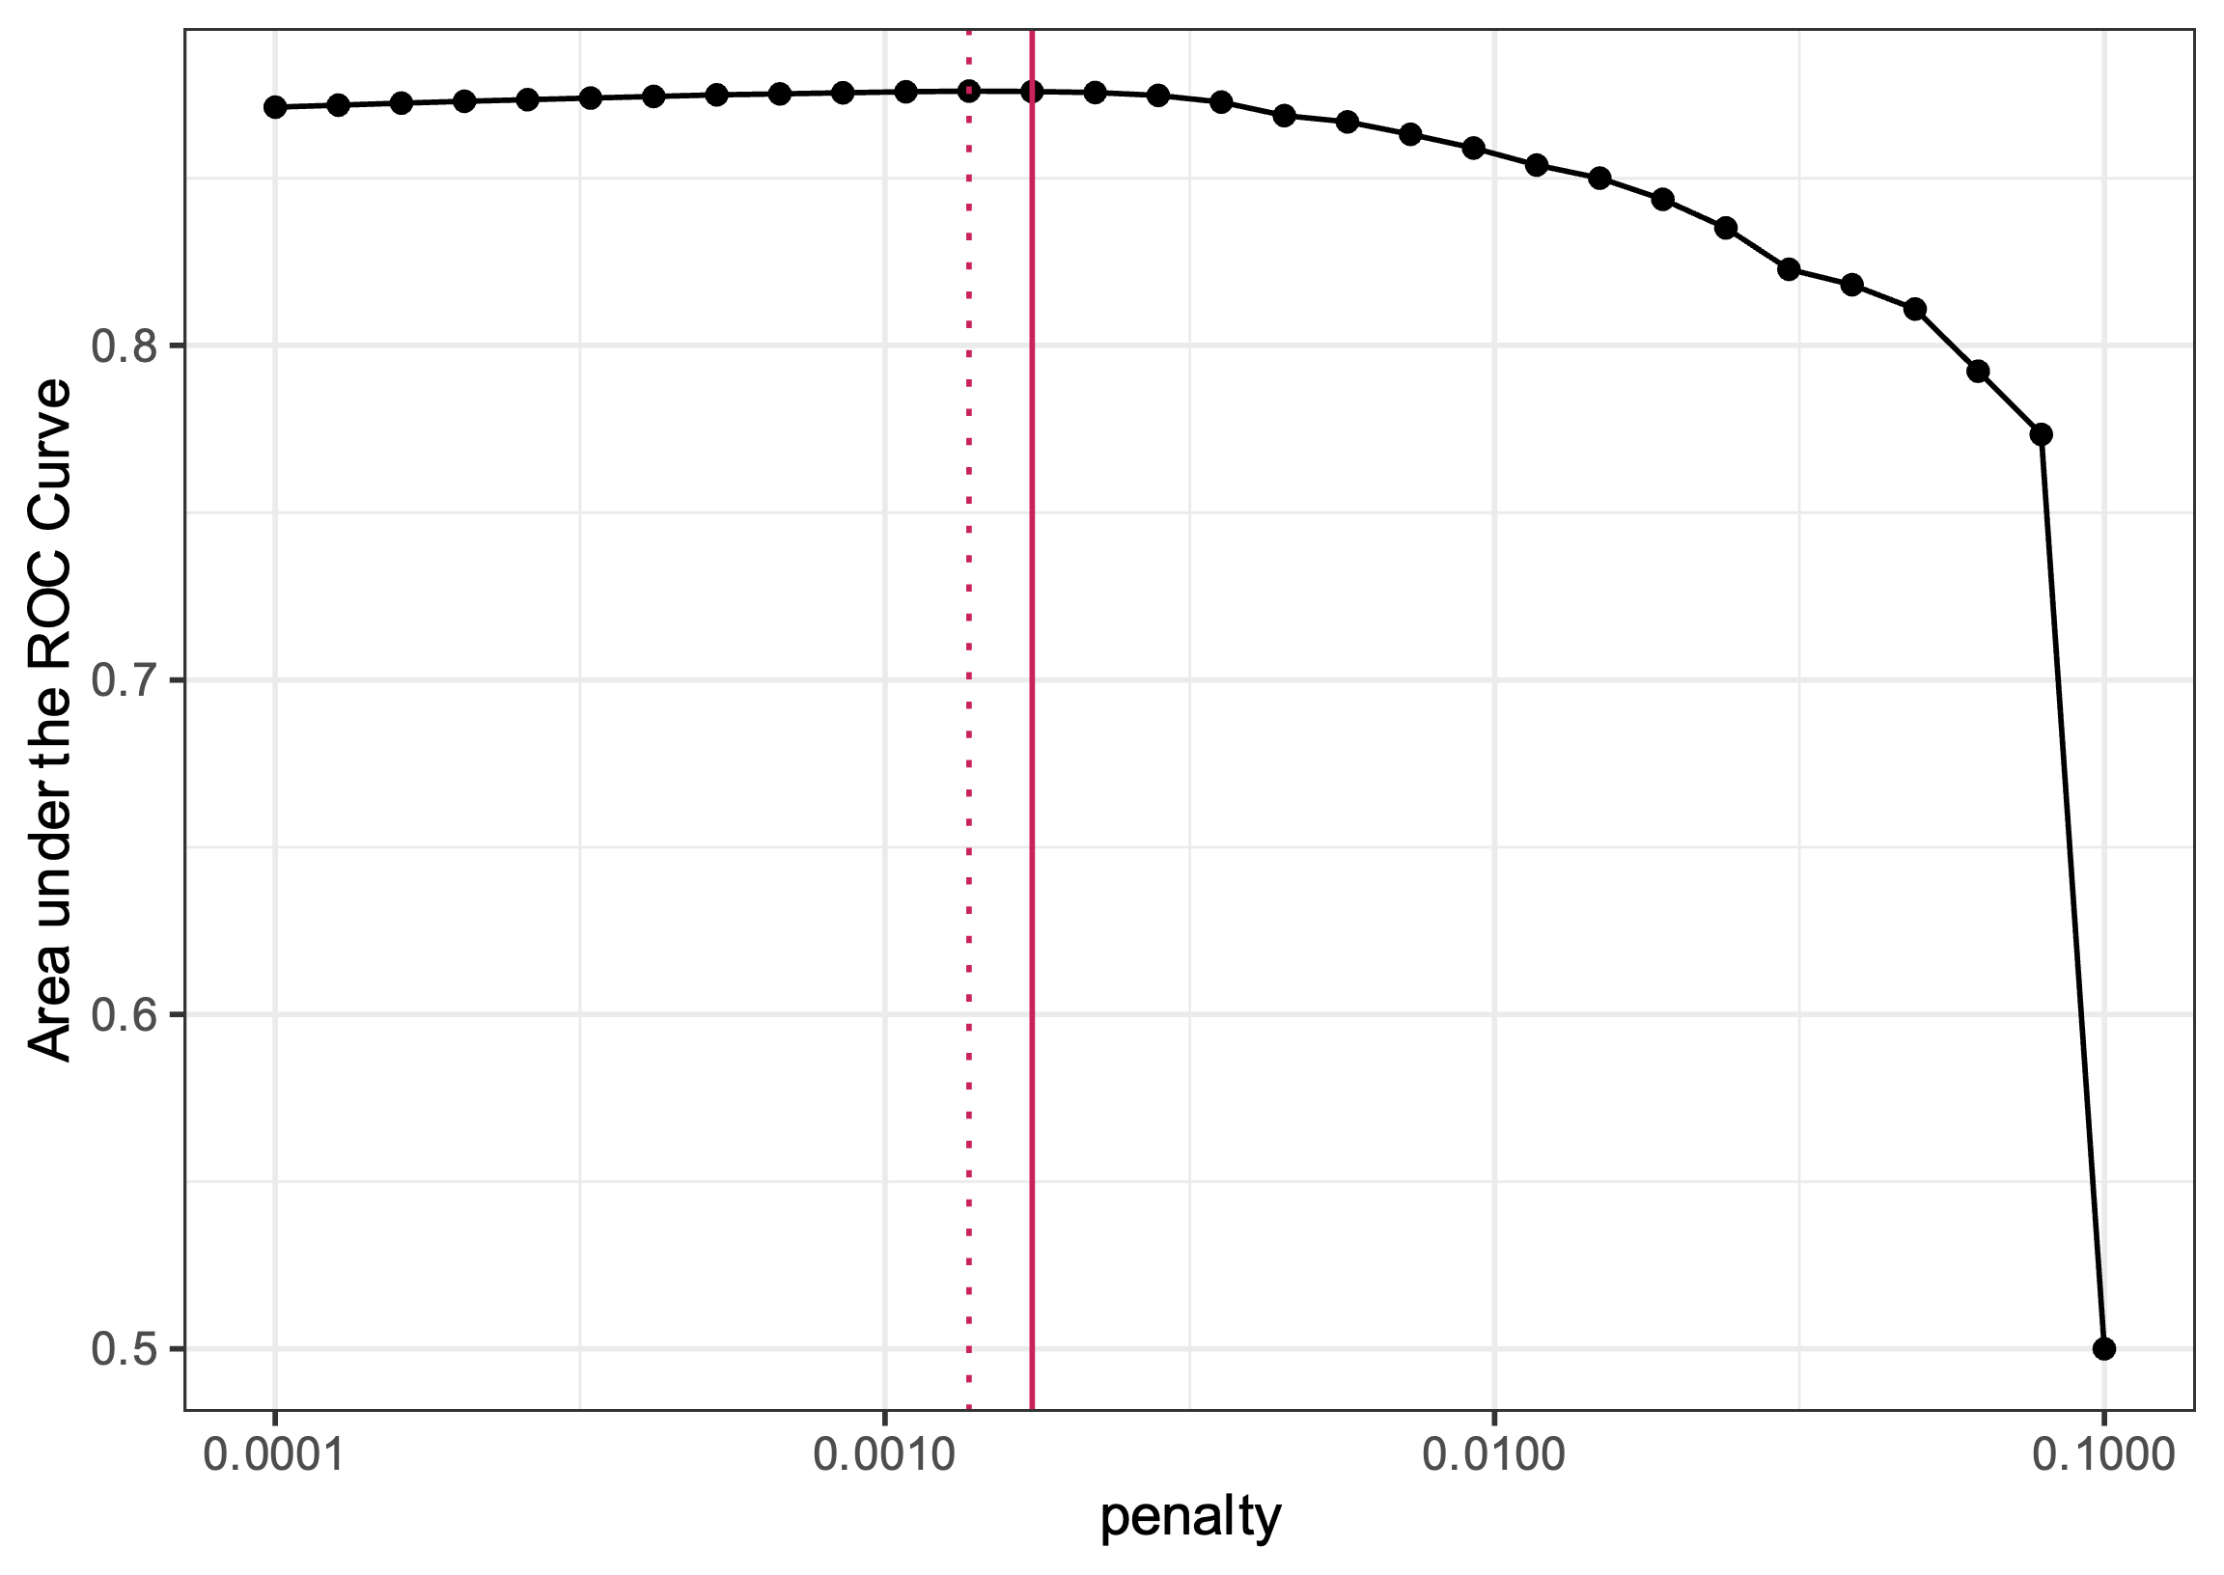
LASSO (Least Absolute Shrinkage and Selection Operator)
LASSO (linear_reg(penalty = tune(), mixture = 1)): Type of linear regression that performs both variable selection and regularization to enhance the prediction accuracy and interpretability of the resulting statistical model.
Variable Selection: LASSO performs feature selection by shrinking some of the regression coefficients to exactly zero. This means that LASSO can identify the most important predictor variables and effectively remove the less important ones from the model.
Regularization: LASSO applies a penalty to the magnitude of the regression coefficients, which encourages sparsity in the model.
Notes:
Note: We have only restructured the data and removed non data content (e.g., title and descriptions)
The data still contains the same number of cells, but now facilitates machine analysis
Good practice to only include data in your data file and all other contextual information should be addressed in other locations (e.g., ReadMe, data dictionary)

Slide 12
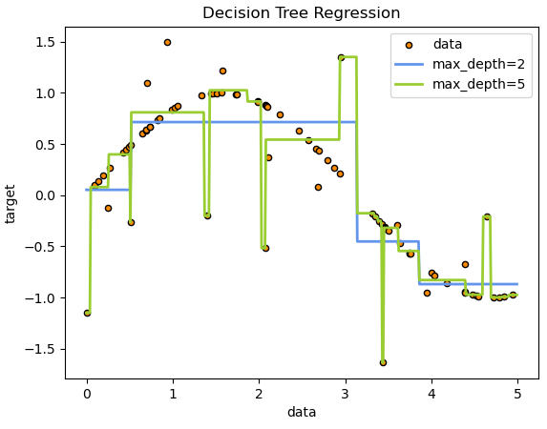
Decision trees
Decision Trees (decision_tree()): Supervised, non-parametric learning algorithm that can be used for both classification and regression tasks. They recursively partition the input space based on feature values to make predictions.
Non-parametric: Model does not make any assumptions about the underlying distribution of the data.
Classification: Classification decision trees are used when the target variable is categorical, meaning it has a finite set of discrete values or classes.
Regression: Regression decision trees, on the other hand, are used when the target variable is continuous, meaning it can take on any numerical value within a range.
Notes:
Note: We have only restructured the data and removed non data content (e.g., title and descriptions)
The data still contains the same number of cells, but now facilitates machine analysis
Good practice to only include data in your data file and all other contextual information should be addressed in other locations (e.g., ReadMe, data dictionary)

Slide 13
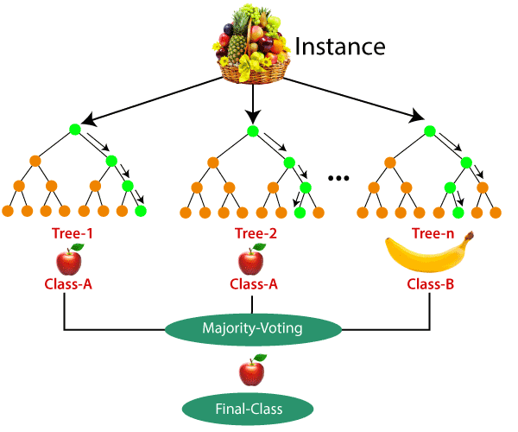
Random forest
Random Forests (rand_forest()): Supervised, non-parametric ensemble learning method that combines multiple decision trees to improve the overall predictive performance and reduce the risk of overfitting.
Ensemble learning method: Combines multiple individual models to produce a more accurate outcome
Multiple decision trees: Random forests are composed of numerous decision trees, each trained on a random subset of the training data and a random subset of the features.
Bagging (Bootstrap Aggregating): Random forests use bagging, where each decision tree is trained on a bootstrap sample (random sampling with replacement) of the training data.
Feature Randomness: When building each decision tree, random forests consider only a random subset of the available features at each split, rather than using all features.
Aggregation: The final prediction of the random forest model is made by aggregating the predictions of the individual decision trees, typically through majority voting (classification) or averaging (regression).
Notes:
Note: We have only restructured the data and removed non data content (e.g., title and descriptions)
The data still contains the same number of cells, but now facilitates machine analysis
Good practice to only include data in your data file and all other contextual information should be addressed in other locations (e.g., ReadMe, data dictionary)

Slide 14
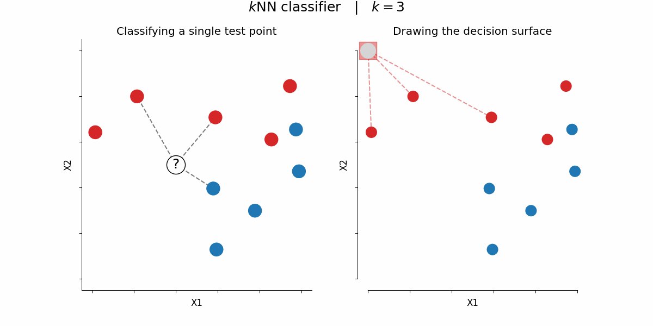
K-nearest neighbors
K-Nearest Neighbors (nearest_neighbor()): Supervised, non-parametric algorithm used for both classification and regression tasks. It makes predictions based on the similarity of the input data to the training samples.
Uses the known target values of the training data to make predictions on new, unseen data. The algorithm identifies the k nearest neighbors of a new data point based on the similarity of their input features, and then uses the target values of those neighbors to predict the target value of the new data point.
Notes:
Note: We have only restructured the data and removed non data content (e.g., title and descriptions)
The data still contains the same number of cells, but now facilitates machine analysis
Good practice to only include data in your data file and all other contextual information should be addressed in other locations (e.g., ReadMe, data dictionary)

Slide 15
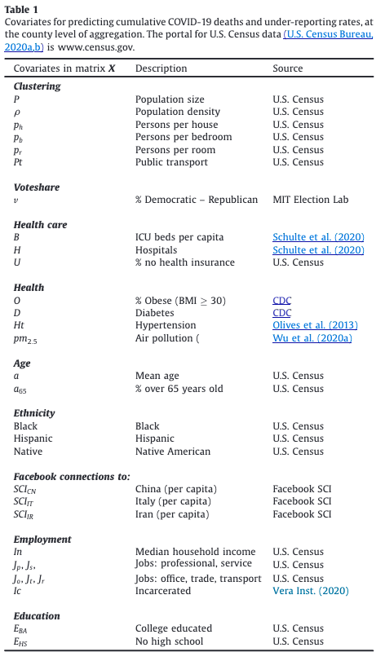

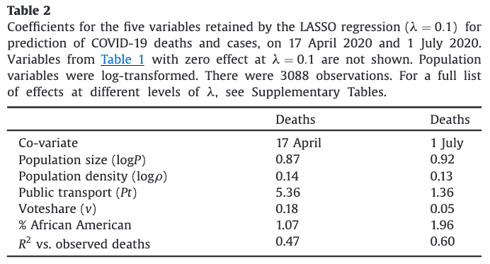
Example publication
https://doi.org/10.1016/j.ehb.2021.100988
Notes:
Note: We have only restructured the data and removed non data content (e.g., title and descriptions)
The data still contains the same number of cells, but now facilitates machine analysis
Good practice to only include data in your data file and all other contextual information should be addressed in other locations (e.g., ReadMe, data dictionary)

Slide 16
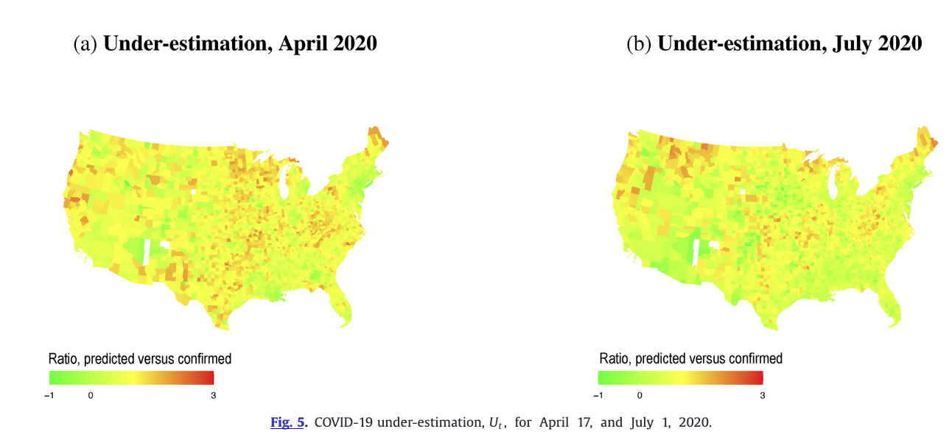
Example publication
https://doi.org/10.1016/j.ehb.2021.100988
Notes:
Note: We have only restructured the data and removed non data content (e.g., title and descriptions)
The data still contains the same number of cells, but now facilitates machine analysis
Good practice to only include data in your data file and all other contextual information should be addressed in other locations (e.g., ReadMe, data dictionary)

